Slide 1


Slide 2
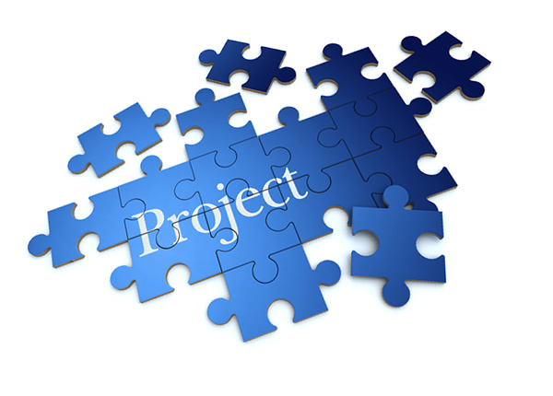
Outline
Introduction
Project background, requirements
User stories and Tasks
Time Estimates
Milestone Scheduling
Building and testing
Demo of software application
https://kirankumarbommana.files.wordpress.com/2014/07/projectmanagement.jpg
Notes:
Project Outline description - how the different pieces of the puzzle came together

Slide 3
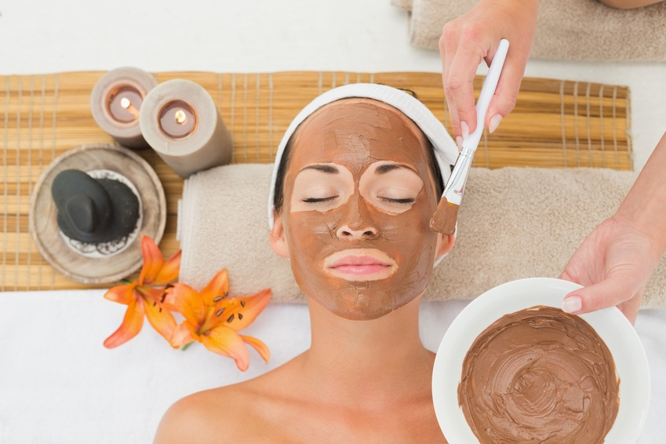
Introduction
Our customer (MiYE spa) has requested us to create a software to support the spa’s front desk to manage spa service reservations and billings for their customers
http://www.burkewilliamsspa.com/wp-content/uploads/2014/07/BW_mud.jpg
Notes:
Objective of MiYE spa software development project - To share with the class how we implemented agile software design concepts in the design of the software.

Slide 4
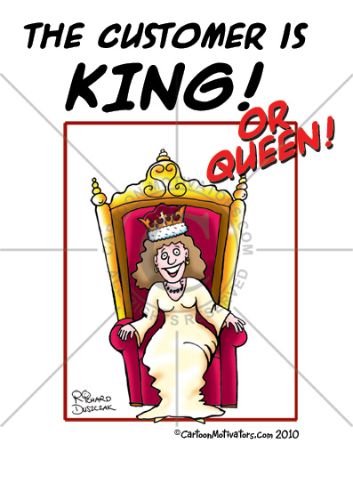
User Stories
Break customer requirements into user stories
Break user stories into tasks
Notes:
User story - who, why, what. Purpose of project from user perspective
Refine, clarify correct user story based on the requirements of the customer
in time, on budget

Slide 5
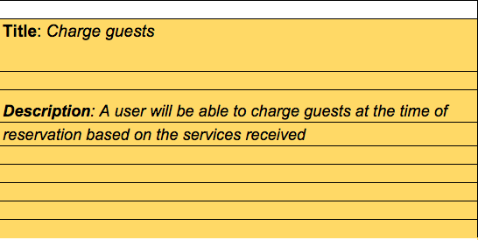
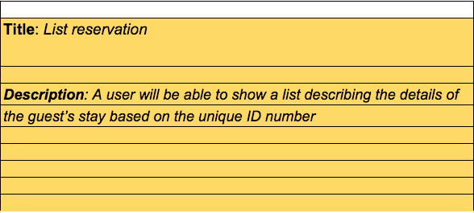
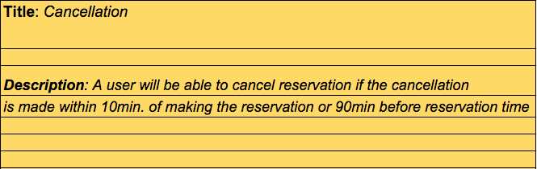
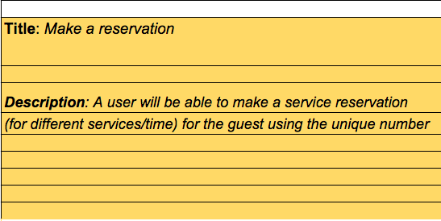
User Story

Slide 6
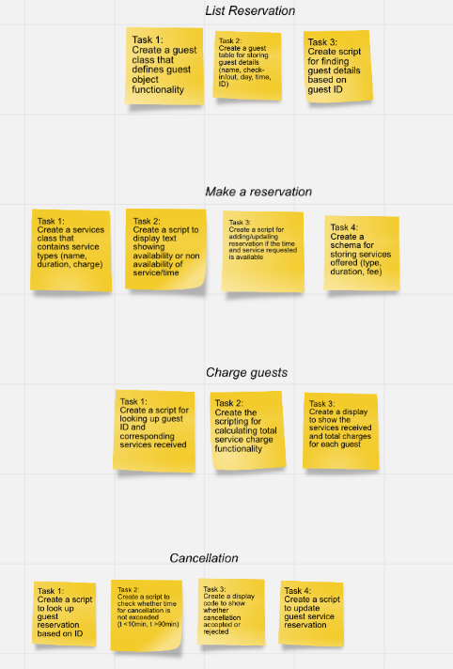
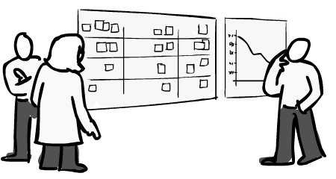
User Stories and Tasks
Project requirements to achieve the desired functionality from the programmer’s perspective.
http://thecriticalpath.info/wp-content/uploads/2010/09/kanban_burndown.png

Slide 7
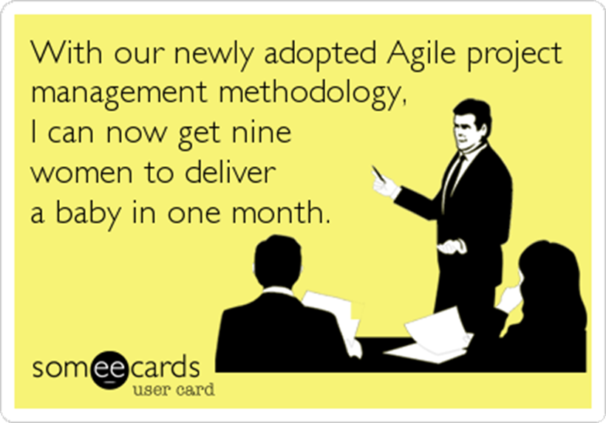
http://cdn.someecards.com/someecards/usercards/MjAxMy0yOTVjYThjMGIyMDVmM2Fl_511a6ca97280d.png

Slide 8
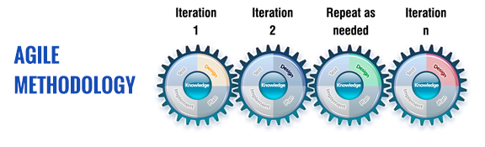
First Iteration
Authenticate guest
Make a service reservation
Test

Slide 9
User Story 1
Tasks
1. Create “list reservation” class
2. Create user interface to navigate system
3. Create user interface to display services
available
4. Create user interface to book a reservation
Priority: 1
Time Estimate: 5 days
Notes:
Example objectives
At the end of this lesson, you will be able to:
Save files to the team Web server.
Move files to different locations on the team Web server.
Share files on the team Web server.

Slide 10
User Story 2
mmmmm
Tasks
Create “make reservation” class
create function to validate date
Validate reservation
Priority: 1
Time Estimate: 6 days

Slide 11
Second Iteration
Calculate service charges
Cancel a reservation
Test

Slide 12
User Story 3
Tasks
Create “charge guests” class
Validate service reservations
Add function to calculate costs for services
Priority: 2
Time Estimate: 5 days

Slide 13
User Story 4
Tasks
Create “cancel reservation” event class
Validate cancellation
Confirm cancellation
Priority: 2
Time Estimate: 5 days

Slide 14

Time Estimates
Team Size = 5
09/09/2015- Customer Requirements
09/23/2015- User Stories Ready
10/14/2015- Milestone 1.0 Due Date
Calendar days = Due Date - User Story Date = 21 days
Week Days = (21* 5/7) = 15 days

Slide 15
Time Estimates
Team members = 5
Days of work (estimate) = 21
Days before Milestone 1.0 = 21
Week days remaining = 21 * 5/7 = 15 days
Available work days = 15 * 0.25 (velocity) = 3.75 days
Work (person-days) available = 3.75 * 5 = 18.75
Days of work deferred = ( 21- 18.75) = 2.25 days **
** One team member left to attend to personal emergency matters

Slide 16
Milestone 1.0 Scheduling
5(team) * 10 (actual working days/iteration) * 0.25 (velocity) = 12.5 days (work in person-days/iteration)
Total Milestone Estimate:
12.5 * 2 (Iterations in Milestone 1.0) = 25 days (work in person-days/milestone)*
* = 20 person-days days for a team of 4

Slide 17
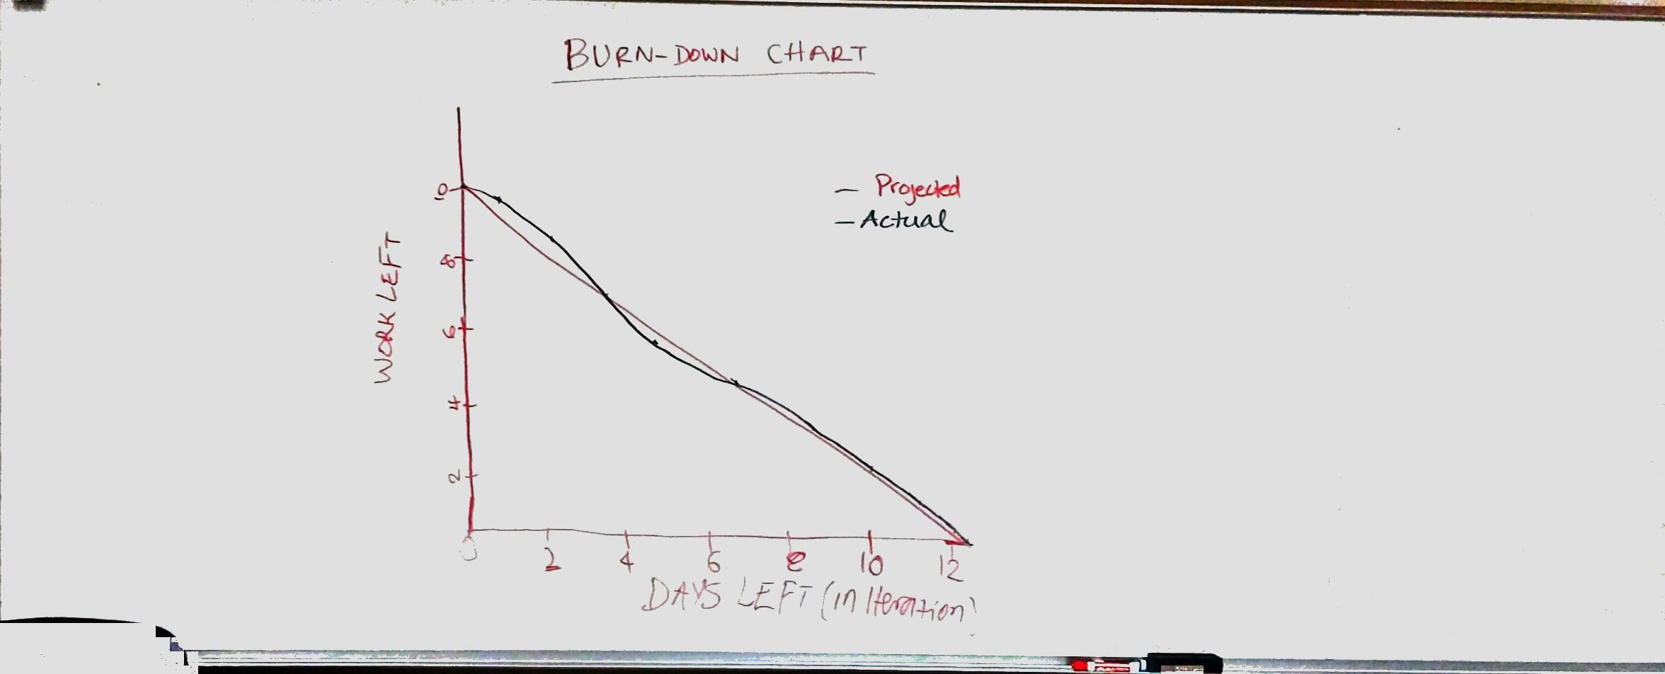
Burn-Down Chart

Slide 18
Building and Testing
Our group decided to do the programing in java but due to most of the group member not knowing Java and also due to one of the group member not being able to continue on the project we decide to recreate the program using Python so that all the group member could have a proper idea of how the system is created and how its functioning
Each member was assigned different tasks and according to the tasks created from the user story.
Due to some of the group members having basic level knowledge about the programing and as we are here to learn and are assigned to a group to help each others out, the system took a bit more time than anticipated.
All the group members have had some or more input on the programing and developing side of the system.
The main task that was set in mind of all the group members while creating the system was; MEETING THE CUSTOMER’S REQUIREMENT keeping the flexibility of the system in mind as the needs or demands of the customer may grow.

Slide 19
Building and Testing
We decided to go with the flat file for the storing or the user details, list services provided and storing of the file to bill the user later.
We tried to meet the customer’s requirement as much as possible and also incorporate all the task book talks about.
We have not managed to create a system that is fully functional but for the final submission of the project we are certain that we will be able to hand over a fully functional and working software as we now have more knowledge in programing as a group and understand each other's strengths and weaknesses.
A small test plan of the system is on the next page.

Slide 20
Test ID | Test Case | Expected Result | Actual Result
1 | To test what happens if the customer inputs something that is not present on the menu option | The system throws exception telling customer that the entry is invalid and asks customer to re-enter the option | The system throws exception telling customer that the entry is invalid and asks customer to re-enter the option
2 | To test what happens if the customer ID is invalid | The system throws exception telling customer that the entry is invalid and asks customer to re-enter the customer ID | The system throws exception telling customer that the entry is invalid and asks customer to re-enter the customer ID
3 | To test what happens if the customer tries to book service past their check-out date | The system throws exception telling customer that the date selected is past their check-out date and asks customer to re-enter the date | The system throws exception telling customer that the date selected is past their check-out date and asks customer to re-enter the date
4 | To test what happens if the customer tries to book service post their check-in date | The system throws exception telling customer that the date selected is post their check-in date and asks customer to re-enter the date | *Not done yet
5 | To test what happens if the reservation clashes | The system throws exception telling customer that the time selected is not available and asks customer to re-enter the time | The system throws exception telling customer that the time selected is not available and asks customer to re-enter the time
6 | To test if the customer is able to cancel the reservation | The customer is able to cancel reservation | The customer is able to cancel reservation
7 | To test if the system saves the record of all the services booked by the customer | The record of the services booked by the customer is saved | The record of the services booked by the customer is saved
8 | To test if the clerk is able to present the bill to the customer for all the services booked | The system allows clerk to present the bill to the customer | The system allows clerk to present the bill to the customer

Slide 21
Big Board
User Stories | Tasks in Progress | Completed Tasks
List Reservation |  | Create user interface to navigate system Create user interface to display services available Create user interface to book a reservation Create “list reservation” event class
Make A Reservation |  | Create “make reservation” class create function to validate date Validate reservation
Charge Guests | Create “charge guests” class Validate service reservations Add function to calculate costs for services
Make A Cancellation | Create “cancel reservation” event class Validate cancellation Confirm cancellation

Slide 22
Demo of Software
Summarize important points.

Slide 23
Questions

